Slide 1
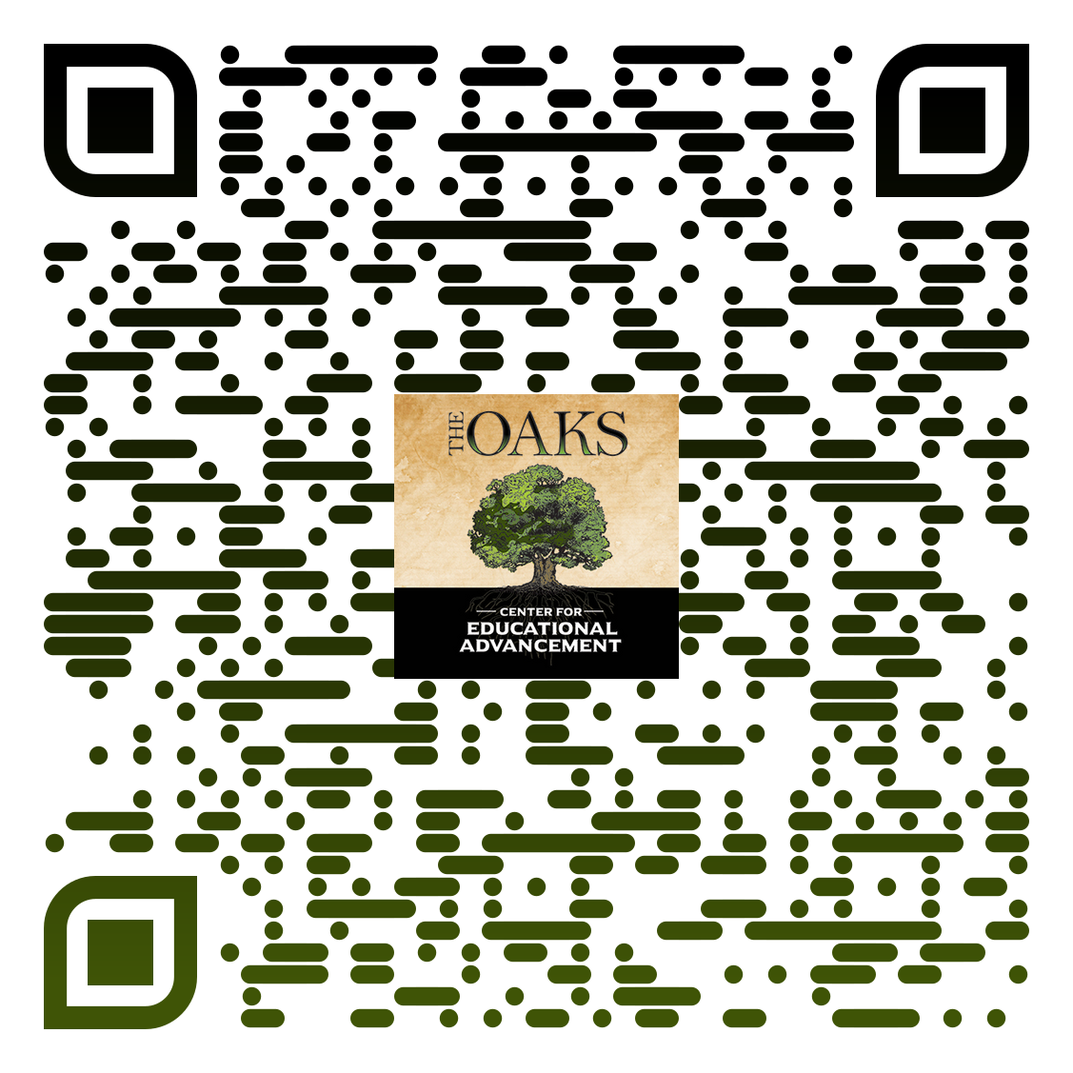
Welcome!
https://oakseducationcenter.com/

Slide 2
Objectives for Today
Develop a Shared Understanding
Identify Key Challenges and Opportunities
Explore Targeted Solutions
Create Actionable Plans
Commit to Continuous Growth

Slide 3
Glow and Grow
Glow: What has been shining in your assessment practices? What are you most proud of or feel worked well?
Grow: What aspect of your assessment practices could benefit from refinement or further development?

Slide 4
Framing the conversation: What is assessment?
What does assessment mean to you in your daily teaching context?
How do York teachers define assessment?
How do York teachers use assessment as a tool for equity and inclusion?
Outcome:
Establish a shared understanding of assessment to frame the rest of the session.

Slide 5
Review of key issues from focus groups and surveys
Student engagement and motivation
Equity and fairness in assessment
Rubrics, Feedback, and Assessment Design
Process:
Review handout​
Jot down reflections, questions, and/or connections​
Turn and talk

Slide 6
Topic Selection
Select two out of the three key issues to focus on with your department
Round 1: 10:20-10:40
Round 2: 10:40-11:00
Student Engagement and Motivation
Equity and Fairness in Assessment
Rubrics, Feedback, and Assessment Design

Slide 7
Department share-outs
Share key takeaways from your department discussions.
As a group, highlight themes, trends, emerging priorities.

Slide 8
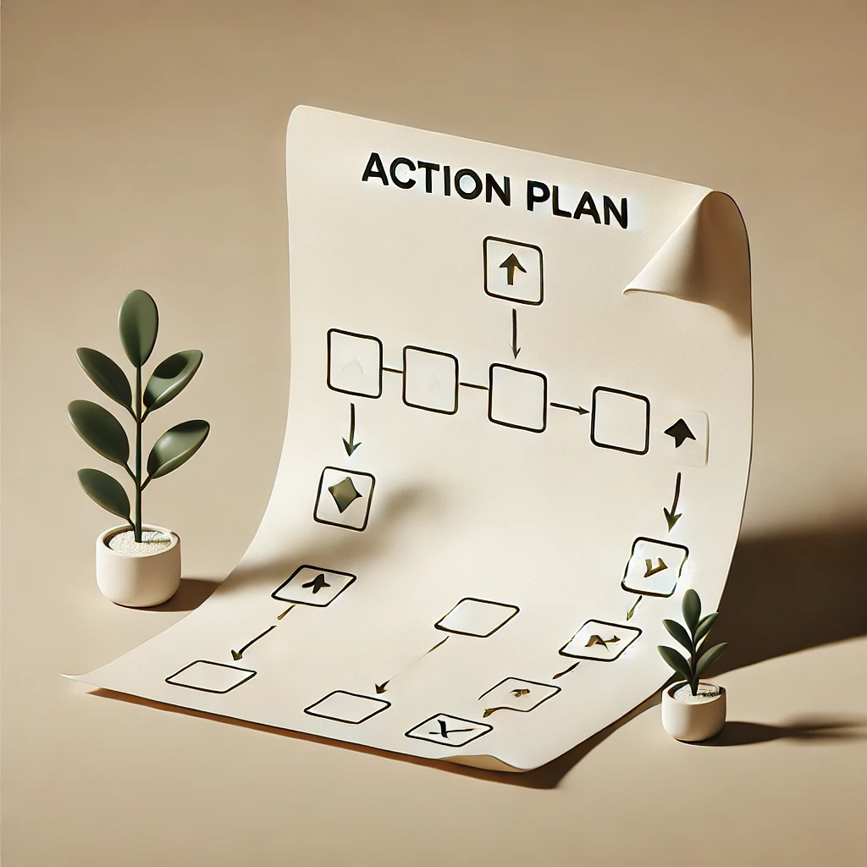
Reflections, Action Plans, Next Steps
Guided Reflection:
What are your key takeaways from today's session?
What actions will you take to improve your assessment practices?
Action Plan Creation:
Identify specific action steps.
Each department commits to at least one concrete action to implement in their practice.

Slide 9
Questions?

